Slide 1
Topic 1. Public and municipal finance in the digital economy

Slide 2
Table 1. Main characteristics of digital economy

Slide 3
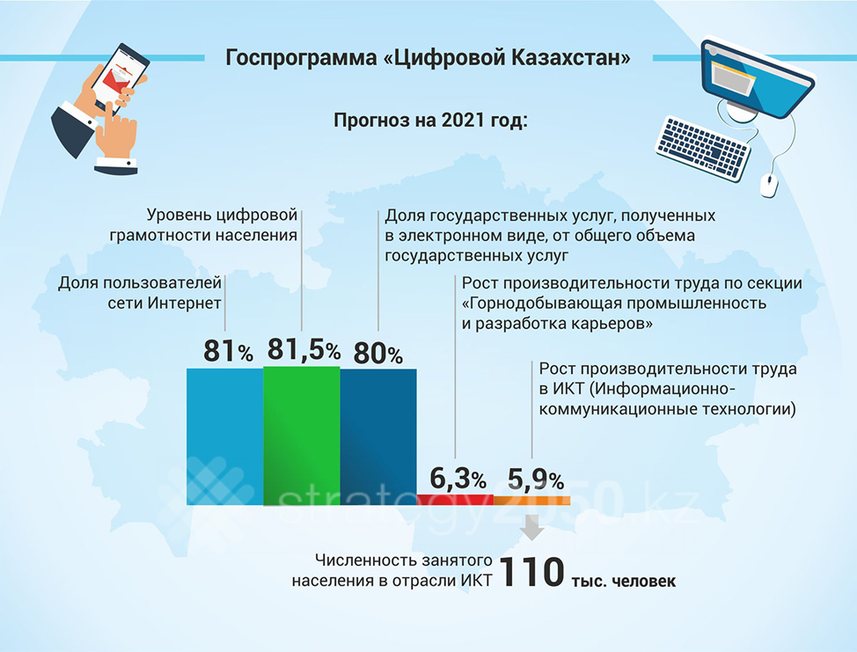

Slide 4
Digitalization rating
According to their research, Singapore, the United Kingdom, New Zealand, the United Arab Emirates, Estonia, Hong Kong, Japan and Israel have become the “digital elite”:
Leaders: Singapore, UK, New Zealand, UAE, Estonia, Hong Kong, Japan and Israel demonstrate high rates of digital development, maintain it and continue to lead in the diffusion of innovations.
Slower Growth: South Korea, Australia, as well as countries in Western Europe and Scandinavia have shown strong growth for a long time, but now they have noticeably slowed down the pace of development. Without the introduction of innovations, these states run the risk of lagging behind the leaders of digitalization.
Forward-looking: Despite the relatively low overall level of digitalization, these countries are at the peak of digital development and are showing steady growth rates, which attracts investors. China, Kenya, Russia, India, Malaysia, Philippines, Indonesia, Brazil, Colombia, Chile, Mexico have the potential to take the lead.
Challenging: Countries such as South Africa, Peru, Egypt, Greece, Pakistan face serious challenges associated with low digital development and slow growth.

Slide 5
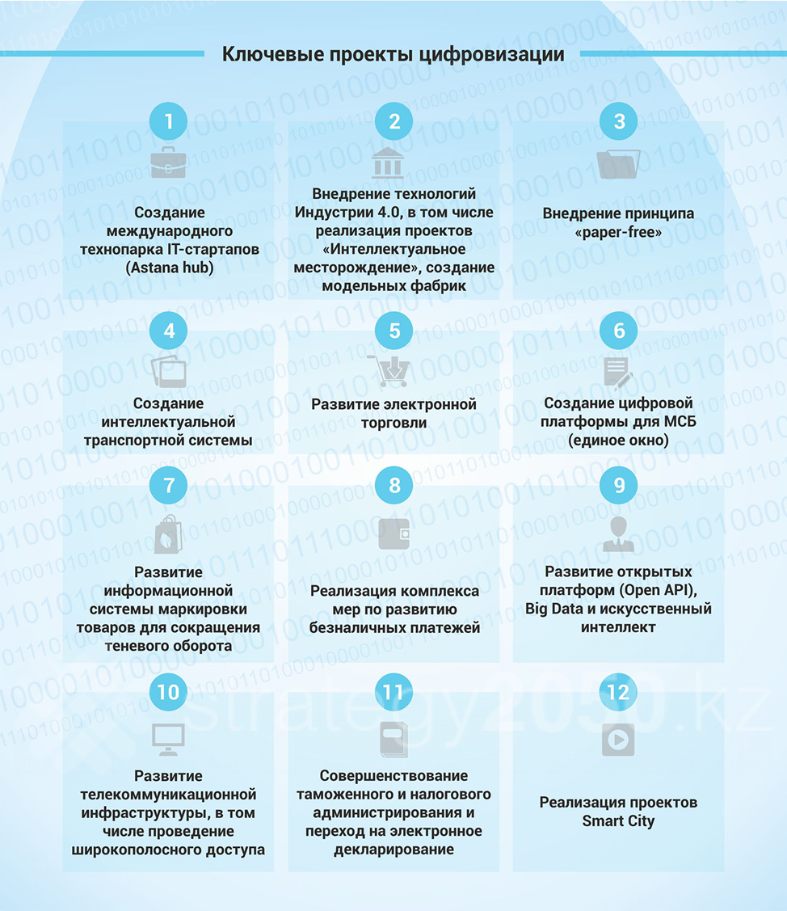
Pros of digitalization

Slide 6
Digitalization of personnel
Digitalization is significantly ahead of the existing system of production requirements for the composition of professions employed in the labor market.
For the development of technical and vocational, higher and postgraduate education in order to bring industry and education closer together, measures are envisaged for the creation of ICT departments of universities at enterprises, as well as centers of competence.

